Slide 1
THU Plan FY21 Vehicle Mounted Relay
Zhanyuan Xie
2021/12/13

Slide 2
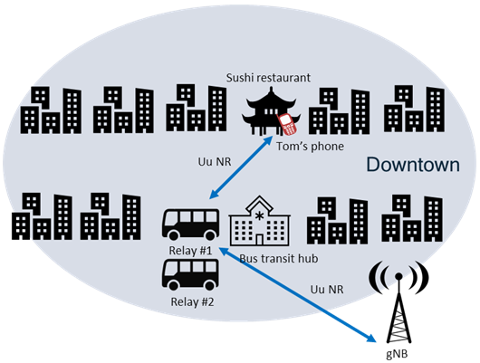
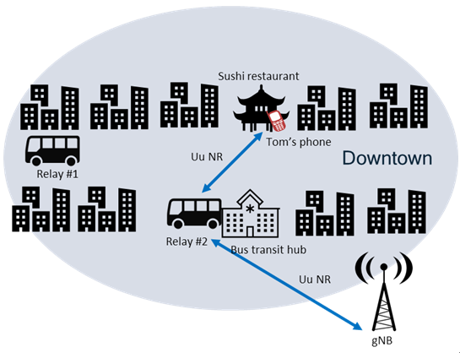
Service Continuity During Handover between Mobile Relays—User Outside the Vehicle
Scenario，Problem & Proposal
Scenario:
We consider the scenario of V2X communications where the vehicles are equipped with the mobile base station relay. In this scenario, handover is happened frequently due to the mobility of the vehicle, which causes interruption for the ongoing services at the UE. To solve this problem, vehicles with known or predictable itinerary(e.g., buses, trams in public transportation) is considered to minimize handover times to the most extent. What is more, caching could also be exploited to enhance service continuity.
[1] S1-204238, Use case on service continuity during mobility between mobile relays – user outside the vehicle

Slide 3

Service Continuity During Handover between Mobile Relays—User Outside the Vehicle
Scenario，Problem & Proposal
Scenario, Problem& Topics
Problem:
In the V2X communication scenario, handover happens frequently due to the mobility of the vehicles, which leads service interruption and degraded user experience. Therefore, there is a need to reduce handover times and guarantee service continuity during the handovers .
Proposal:
We aim at proposing a new mechanism based on relay and caching technology to reduce handovers and improve user experience. With the predictable itinerary, decision can be made to minimize handovers. For non-real-time service, caching can be taken into account to support service continuity when there is no relays in the cell.
Far User
Transmitter
(SCMA)
Near User
Far codeword
decoder
Far codeword
interference
cancellation
Near codeword
decoder

Slide 4
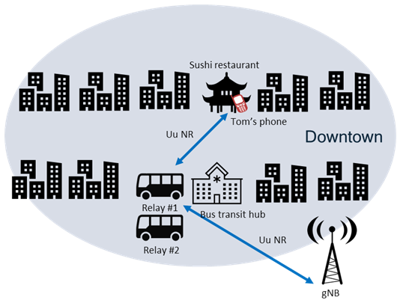
Use Case on Service Continuity During Handover between Mobile Relays – User Outside the Vehicle
Scenario
When users are served by vehicle-mounted relays, handover happens frequently due to the mobility of relays.
Service continuity needs to be promised during handover between mobile relays.
Service Process
The served relay starts to move.
The gNB finds the movement of the served relay.
The gNB makes decisions to handover to guarantee the service continuity.

Slide 5
Survey on Vehicle-Mounted Relays
There has been a TR22.839 “Study on vehicle-mounted relays Vehicle-Mounted Relays”
---- One use case is “Service Continuity During Handover between Mobile Relays – User Outside the Vehicle” (also S1-204238)
SA: The term was discussed in 3GPP SA1#96-e and SA2#148E, now is being discussed as a SID: “SP-211314 Study on Architecture Enhancements for Vehicle Mounted Relays” for approval in SA#94-e (already approved in SA2).
---- “Some of the vehicles can follow a certain known/predictable itinerary (e.g. buses or trams, etc), or be situated in specific locations (e.g. outside stadiums ), through or around areas where extra cellular coverage and capacity would be needed …”
----- WT#1 focuses on service continuity
An alternative term “Mobile IAB” is now being discussed as a WID “RP-213601 Mobile IAB” in 3GPP RAN#94-e,
---- “focus on the scenario of mobile-IAB-nodes mounted on vehicles providing 5G coverage/capacity enhancement to onboard and/or surrounding Ues…”
---- RRM requirements

Slide 6


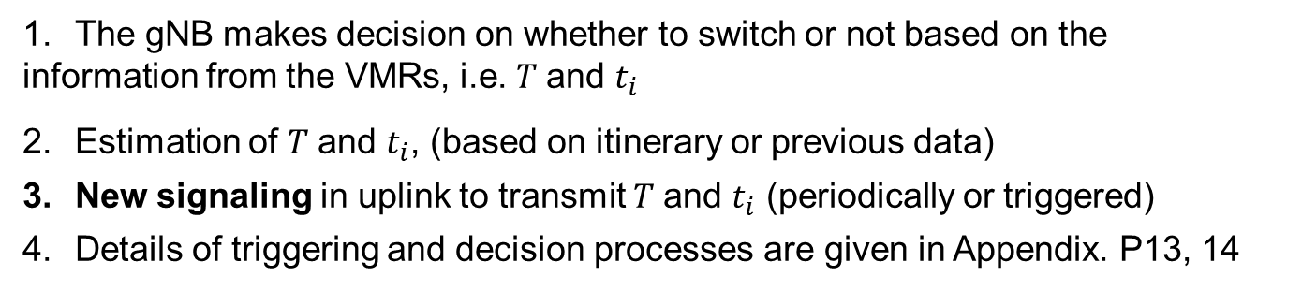
Proposal: Scenario 1
Real-time Service
The gNB makes decision on whether to switch or not based on the information from the VMRs, i.e. $T$and $t_{i}$
Estimation of $T$and $t_{i}$, (based on itinerary or previous data)
New signaling in uplink to transmit $T$and $t_{i}$ (periodically or triggered)
Details of triggering and decision processes are given in Appendix. P13, 14
The serving VMR will leave in $T$
VMR 2
VMR 1
The i-th VMR will leave in $t_{i}$
Switch from VMR 1 to VMR 2

Slide 7

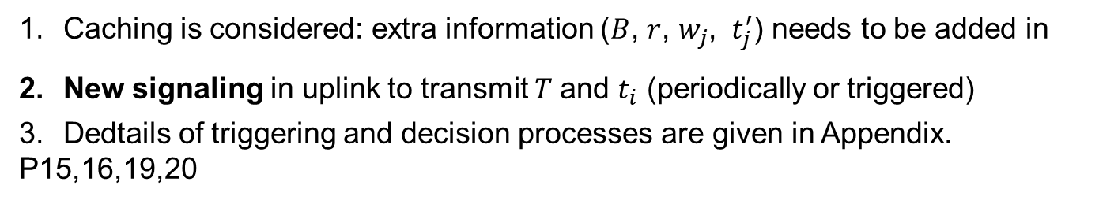


Proposal: Scenario 2
Non-real-time Service
Caching is considered: extra information ($B$, $r$, $w_{j}$, ${ t}_{j}^{′}$) needs to be added in
New signaling in uplink to transmit $T$and $t_{i}$ (periodically or triggered)
Dedtails of triggering and decision processes are given in Appendix. P15,16,19,20
The j-th VMR will arrive in $w_{j}$ and stays for $t_{j}^{′}$
The serving VMR will leave in $T$
VMR 2
VMR 1
The i-th VMR will leave in $t_{i}$
Switch from VMR 1 to VMR 2

Slide 8
Procedure: switch from VMR to VMR
Compared with 3GPP TR 38.836, 4.5 Layer-2 relay, we have the following switch procedures (others in Appendix P15,16,19,20,22,23)
Remote UE
VMR 1
VMR 2
gNB
UL/DL data
New signalings
Reporting
Reporting
Decision
Configuration Message
Configuration
New actions
UL/DL data
Release
Notes:
是否要增加 release？

Slide 9
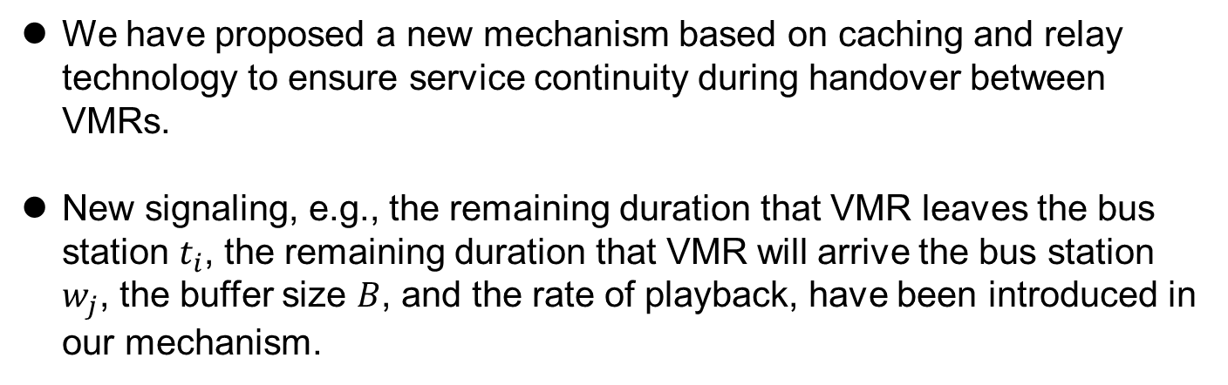
Summary
We have proposed a new mechanism based on caching and relay technology to ensure service continuity during handover between VMRs.
New signaling, e.g., the remaining duration that VMR leaves the bus station $t_{i}$, the remaining duration that VMR will arrive the bus station $w_{j}$, the buffer size $B$, and the rate of playback, have been introduced in our mechanism.

Slide 10
Appendix
The appendix includes:
The triggering and decision processes
Procedures for switching
The relay initial strategy

Slide 11
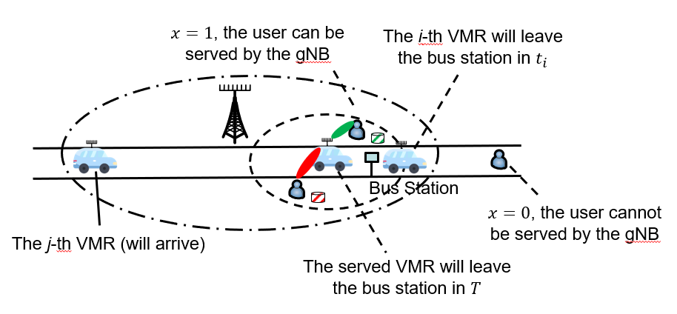
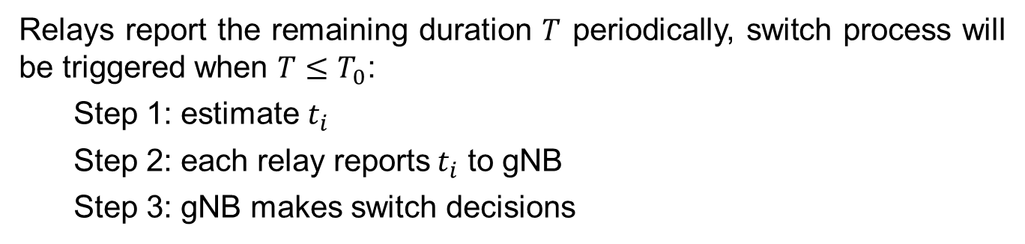

Relay Switch Strategy—Switch from VMR
Triggering Process (for real-time service)
Relays report the remaining duration $T$ periodically, switch process will be triggered when $T≤T_{0}$:
Step 1: estimate $t_{i}$
Step 2: each relay reports$t_{i}$ to gNB
Step 3: gNB makes switch decisions
$T_{0}$: threshold

Slide 12
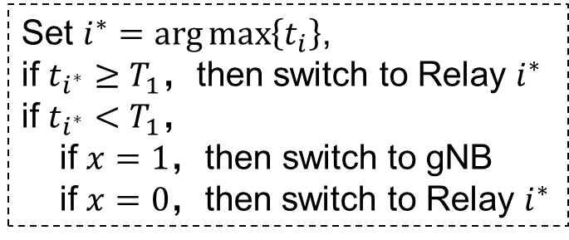
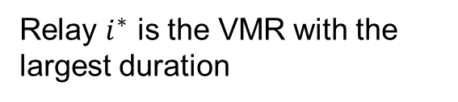

Switch Decision—Switch from VMR
Decision Process (for real-time service)
Relay $i^{∗}$ is the VMR with the largest duration
Set $i^{∗}=\arg{\max\left\{t_{i}\right\}}$,
if $t_{i^{∗}}≥T_{1}$，then switch to Relay $i^{∗}$
if $t_{i^{∗}}<T_{1}$，
if $x=1，$then switch to gNB
if $x=0$，then switch to Relay $i^{∗}$
$T_{1}$: to avoid frequent switches

Slide 13
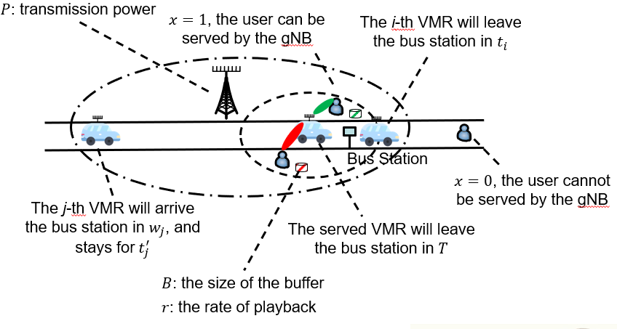
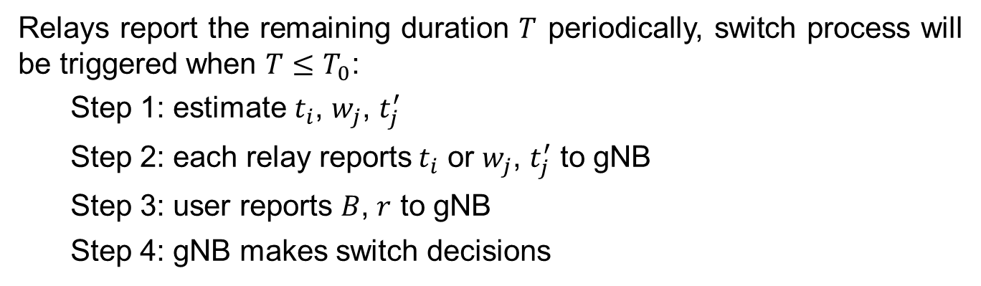
Relay Switch Strategy—Switch from VMR
Triggering Process (for non real-time service)
Relays report the remaining duration $T$ periodically, switch process will be triggered when $T≤T_{0}$:
Step 1: estimate $t_{i}$, $w_{j}$, $t_{j}^{′}$
Step 2: each relay reports$t_{i}$ or $w_{j}$, $t_{j}^{′}$ to gNB
Step 3: user reports $B$, $r$ to gNB
Step 4: gNB makes switch decisions

Slide 14
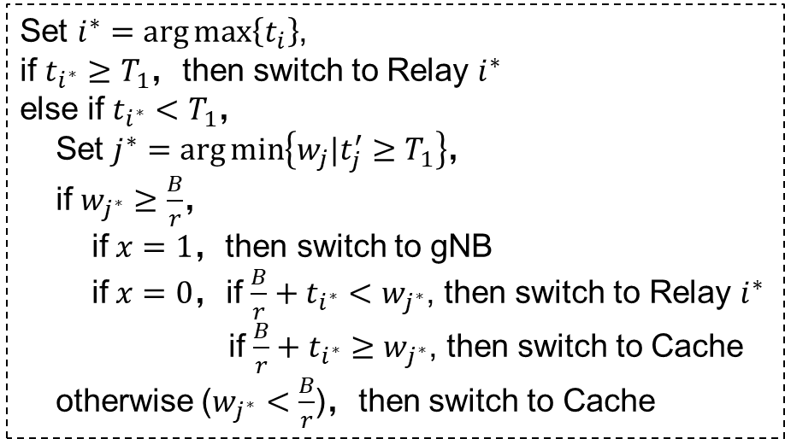
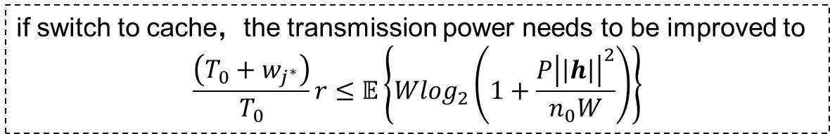
Switch Decision—Switch from VMR
Decision Process (for non real-time service)
Set $i^{∗}=\arg{\max\left\{t_{i}\right\}}$,
if $t_{i^{∗}}≥T_{1}$，then switch to Relay $i^{∗}$
else if $t_{i^{∗}}<T_{1}$，
Set $j^{∗}=\arg{\min\left\{w_{j}|t_{j}^{′}≥T_{1}\right\}}$，
if $w_{j^{∗}}≥\frac{B}{r}$，
if $x=1，$then switch to gNB
if $x=0$，if $\frac{B}{r}+t_{i^{∗}}<w_{j^{∗}}$, then switch to Relay $i^{∗}$
if $\frac{B}{r}+t_{i^{∗}}≥w_{j^{∗}}$, then switch to Cache
otherwise ($w_{j^{∗}}<\frac{B}{r}$)，then switch to Cache
Relay $i^{∗}$ is the VMR with the largest duration
Different from the real-time one, it can exploit the buffer to support the continuity of the service such as playing the cached video, etc.
if switch to cache，the transmission power needs to be improved to
$$\frac{\left(T_{0}+w_{j^{∗}}\right)}{T_{0}}r≤𝔼\left\{Wlog_{2}\left(1+\frac{P{\left|\left|h\right|\right|}^{2}}{n_{0}W}\right)\right\}$$

Slide 15
Procedure: switch from VMR to gNB
Remote UE
VMR 1
VMR 2
gNB
New signalings
UL/DL data
Reporting
Reporting
Decision
Configuration Message
Release
Configuration
UL/DL data

Slide 16
Procedure: switch from VMR to Cache
Remote UE
Cache
VMR 1
gNB
New signalings
UL/DL data
Reporting
Decision
Configuration Message
Configuration
DL/UL data
New actions
Release
DL/UL data

Slide 17
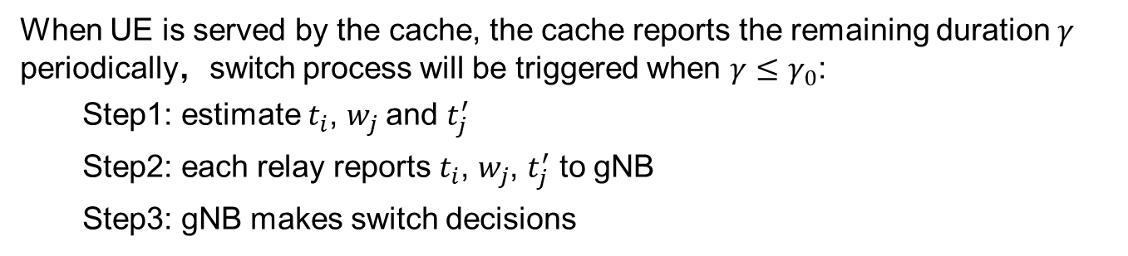
Switch Decision—Switch from Cache
Triggering Process (for non real-time)
When UE is served by the cache, the cache reports the remaining duration $γ$ periodically，switch process will be triggered when $γ≤γ_{0}$:
Step1: estimate $t_{i}$, $w_{j}$and $t_{j}^{′}$
Step2: each relay reports $t_{i}$, $w_{j}$, $t_{j}^{′}$ to gNB
Step3: gNB makes switch decisions

Slide 18
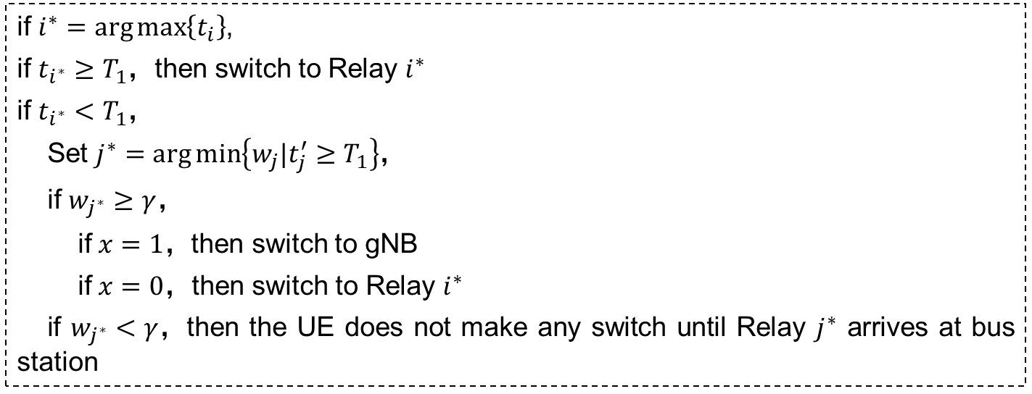
Switch Decision—Switch from Cache
Decision Process (for non real-time)
if $i^{∗}=\arg{\max\left\{t_{i}\right\}}$,
if $t_{i^{∗}}≥T_{1}$，then switch to Relay $i^{∗}$
if $t_{i^{∗}}<T_{1}$，
Set $j^{∗}=\arg{\min\left\{w_{j}|t_{j}^{′}≥T_{1}\right\}}$，
if $w_{j^{∗}}≥γ$，
if $x=1，$then switch to gNB
if $x=0$，then switch to Relay $i^{∗}$
if $w_{j^{∗}}<γ$，then the UE does not make any switch until Relay $j^{∗}$ arrives at bus station

Slide 19
Procedure: switch from Cache to VMR
Remote UE
Cache
VMR 1
gNB
DL/UL data
New signalings
Reporting
Decision
Configuration Message
Configuration
New actions
UL/DL data

Slide 20
Procedure: switch from Cache to gNB
Remote UE
Cache
VMR 1
gNB
DL/UL data
New signalings
Reporting
Decision
Configuration Message
Configuration
New actions
UL/DL data

Slide 21
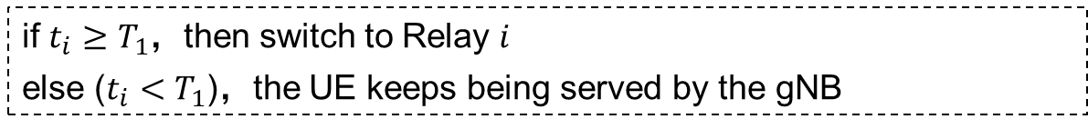
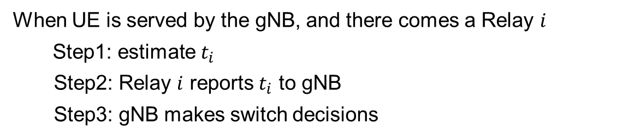
Switch Decision—Switch from gNB
Triggering Process (for both real-time & non real-time)
When UE is served by the gNB, and there comes a Relay $i$
Step1: estimate $t_{i}$
Step2: Relay $i$ reports $t_{i}$ to gNB
Step3: gNB makes switch decisions
Decision Process (for both real-time or non real-time)
if $t_{i}≥T_{1}$，then switch to Relay $i$
else ($t_{i}<T_{1}$)，the UE keeps being served by the gNB

Slide 22
Procedure: switch from gNB to Cache
Remote UE
Cache
VMR 1
gNB
UL/DL data
New signalings
Reporting
Decision
Configuration Message
Configuration
DL/UL data
New actions

Slide 23
Procedure: switch from gNB to VMR
Remote UE
VMR 1
VMR 2
gNB
UL/DL data
New signalings
Reporting
Reporting
Decision
Configuration Message
Configuration
New actions
UL/DL data

Slide 24
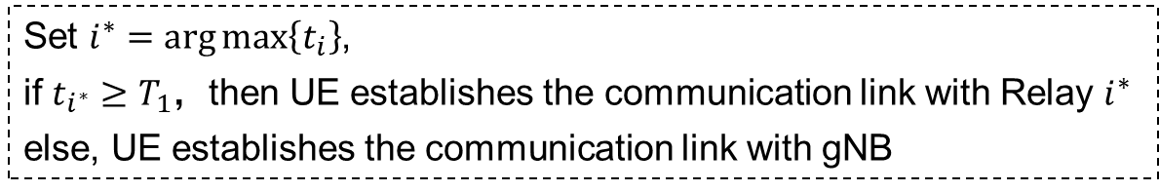
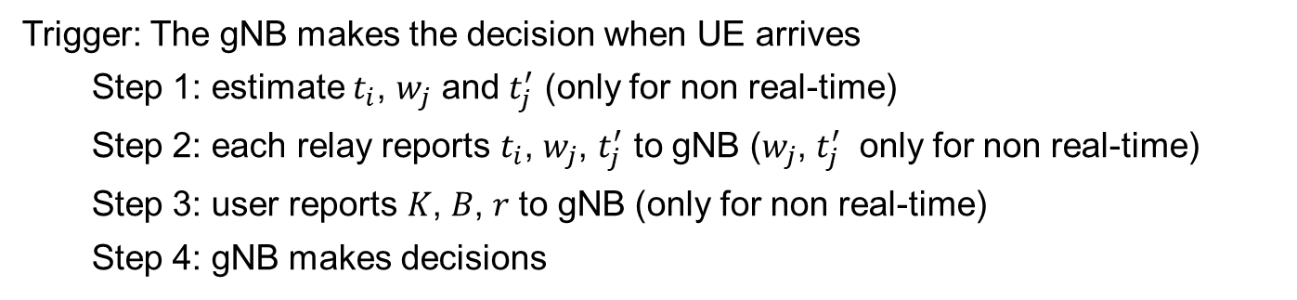
Relay Initial Strategy
Triggering Process (for both real-time or non real-time)
Trigger: The gNB makes the decision when UE arrives
Step 1: estimate $t_{i}$, $w_{j}$ and $t_{j}^{′}$ (only for non real-time)
Step 2: each relay reports $t_{i}$, $w_{j}$, $t_{j}^{′}$ to gNB ($w_{j}$, $t_{j}^{′}$ only for non real-time)
Step 3: user reports 𝐾, 𝐵, 𝑟 to gNB (only for non real-time)
Step 4: gNB makes decisions
Decision Process (for both real-time or non real-time)
Set $i^{∗}=\arg{\max\left\{t_{i}\right\}}$,
if $t_{i^{∗}}≥T_{1}$，then UE establishes the communication link with Relay $i^{∗}$
else, UE establishes the communication link with gNB

